Slide 1
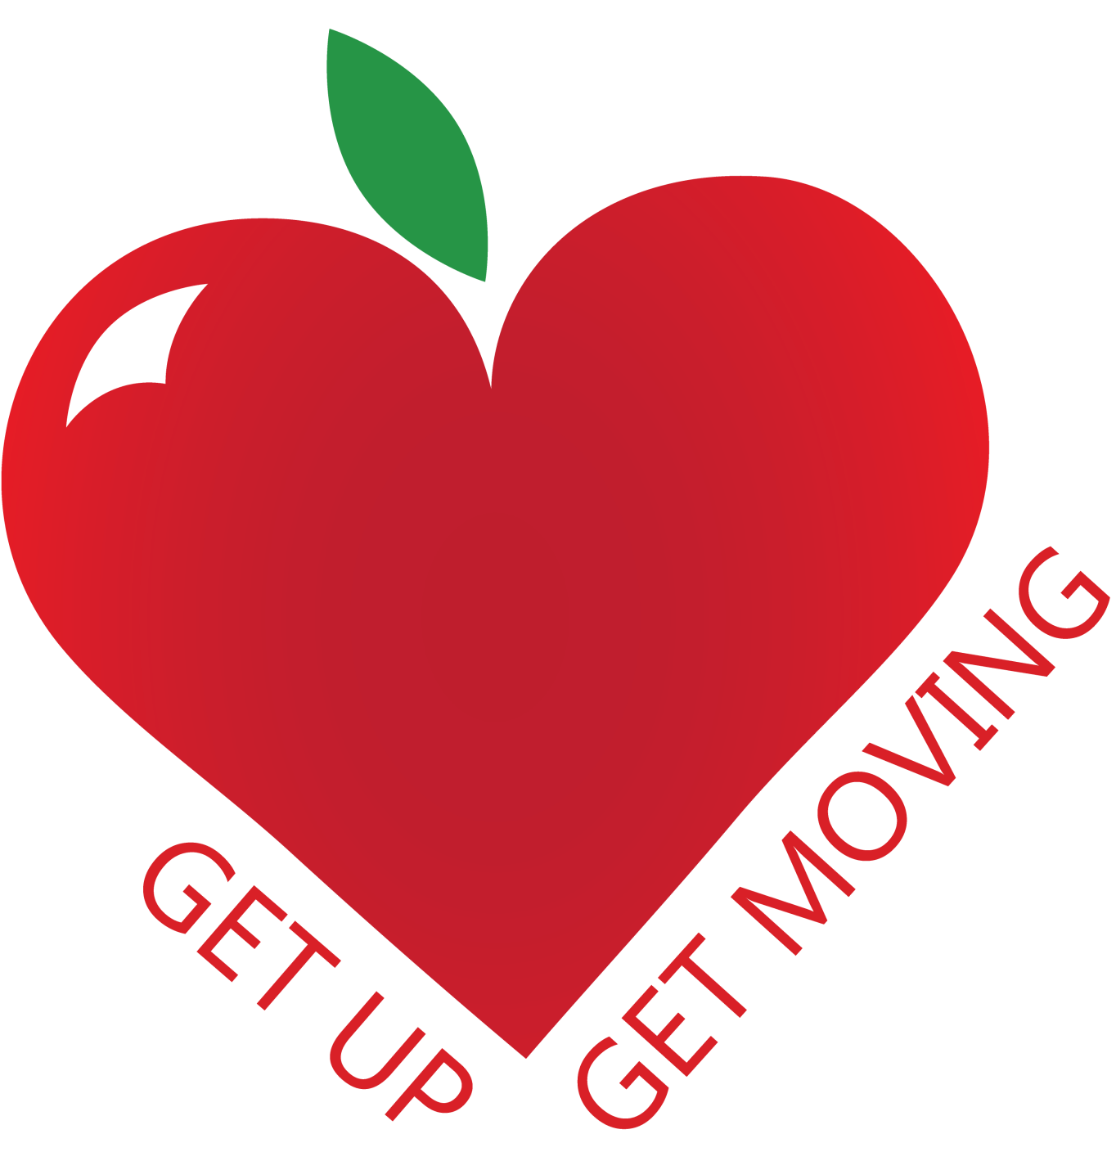
ARE YOU HEALTHY?

Slide 2
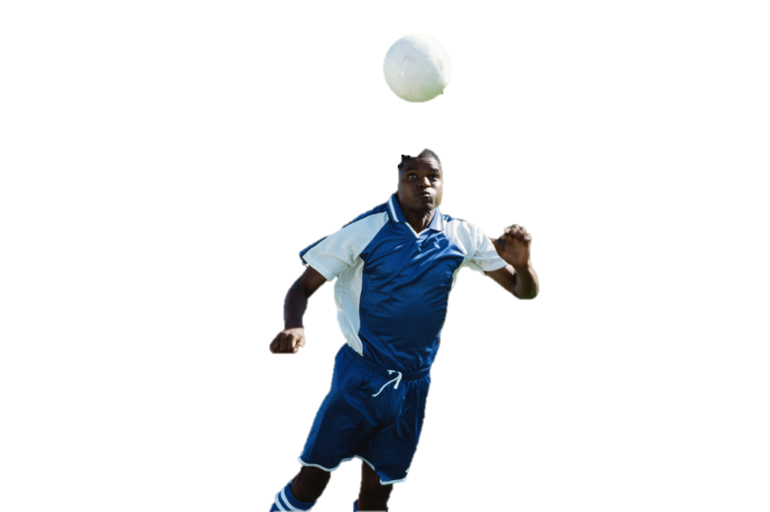
ARE YOU HEALTHY?
Take the Get up Get Moving Quiz and find out whether you’re an Olympic athlete or a couch potato compared to everyone else.
INSTRUCTIONS

Slide 3
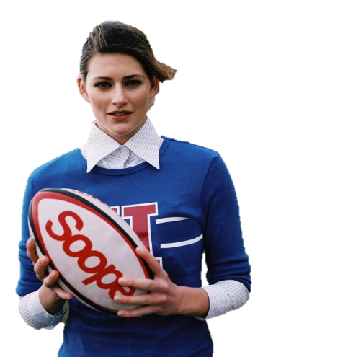
ARE YOU HEALTHY?
This quiz takes about 5 minutes to complete.
Read the question and click the answer that you think is right.
If you get it wrong just click try again.
Count up your points as you go. 1 point per correct answer; on the first go. “Try Again” doesn’t count.
To advance to the next question use the arrows or pill buttons. Please DO NOT use your keyboard.
TAKE THE QUIZ

Slide 4
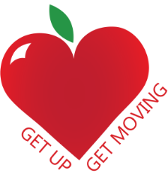
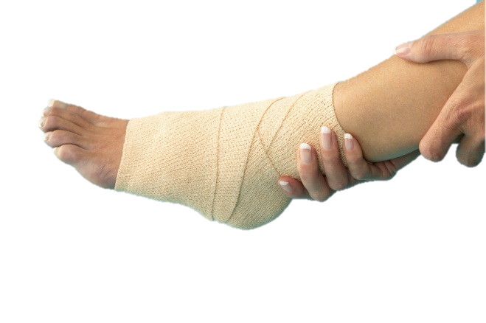
DISCLAIMER
This Get up Get Moving Quiz and it's data are property of Wymondham High Academy. It was built in 2012/2013 and all data and information inside of the quiz is static and will not update. None of the data should be used for medical purposes such as dieting, please consult a doctor or a nutritionist for information. This quiz is for fun and is not a real life representation of how healthy you actually are. Much of the statistics generated for the purpose of this quiz are calculated by taking an average from different websites.
Get up Get Moving claims no liability for any harm caused by using information in this quiz. Please contact Get Up Get Moving for more information about this quiz and the statistics behind it.
ACCEPT
DECLINE

Slide 5
What does BMI stand for?
Body Mass Index
By Moderating Intake
Biggest Medical Indicator
B-Vitamin Modulating Intravenous

Slide 6
How many calories should Men/Women eat a day?
1000 (M)
980 (F)
6000 (M)
6000 (F)
5500 (M)
5750 (F)
2200 (M)
1900 (F)

Slide 7
What is BPM?
Business Process Management Organizing Businesses with feng shui
Beam Propagation Method
Numerical tool for Electromagnetic Analysis
Beats Per Minute
How many times your heart beats in a minute
Bachelor of Procurement Management
A degree

Slide 8
How do you calculate your maximum heart rate
Height × Weight ÷ 100
Age + 1000 ÷ ½ of Weight
220 − Age
(Age × 2) × ¼

Slide 9
How many Fruit and Vegetables should you have a day?
5
9
6
4

Slide 10
Which one has the most calories?
Starbucks Hot chocolate
Big Mac
Cadburys Mini Roll
Tea and two sugars

Slide 11
How many minutes of exercise do adults need a day (PART A)
20
60
120
30

Slide 12
How many days a week do they need to do this? (PART B)
7 days a week
5 days a week
6 days a week
1 day a week

Slide 13
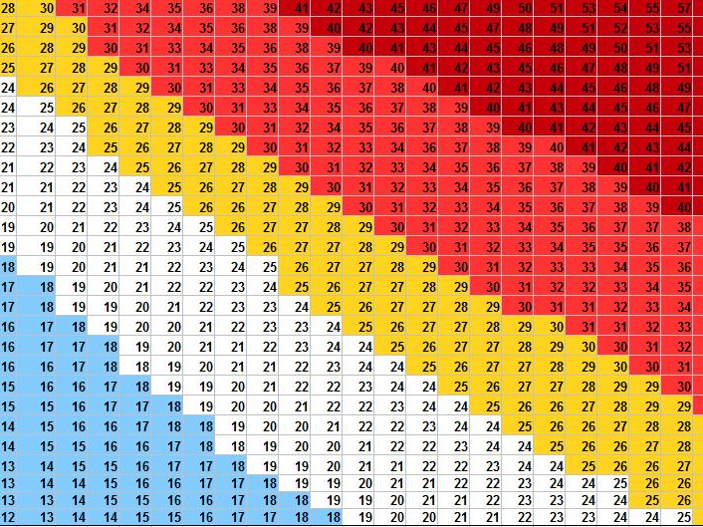

WELL DONE!
BMI Stands for Body Mass Index.
It is a measure of how physically healthy you are for your weight and height.
You can calculate it by:
WEIGHT KG ÷ HEIGHT IN METERS ÷ HEIGHT IN METERS
BMI CHART

Slide 14
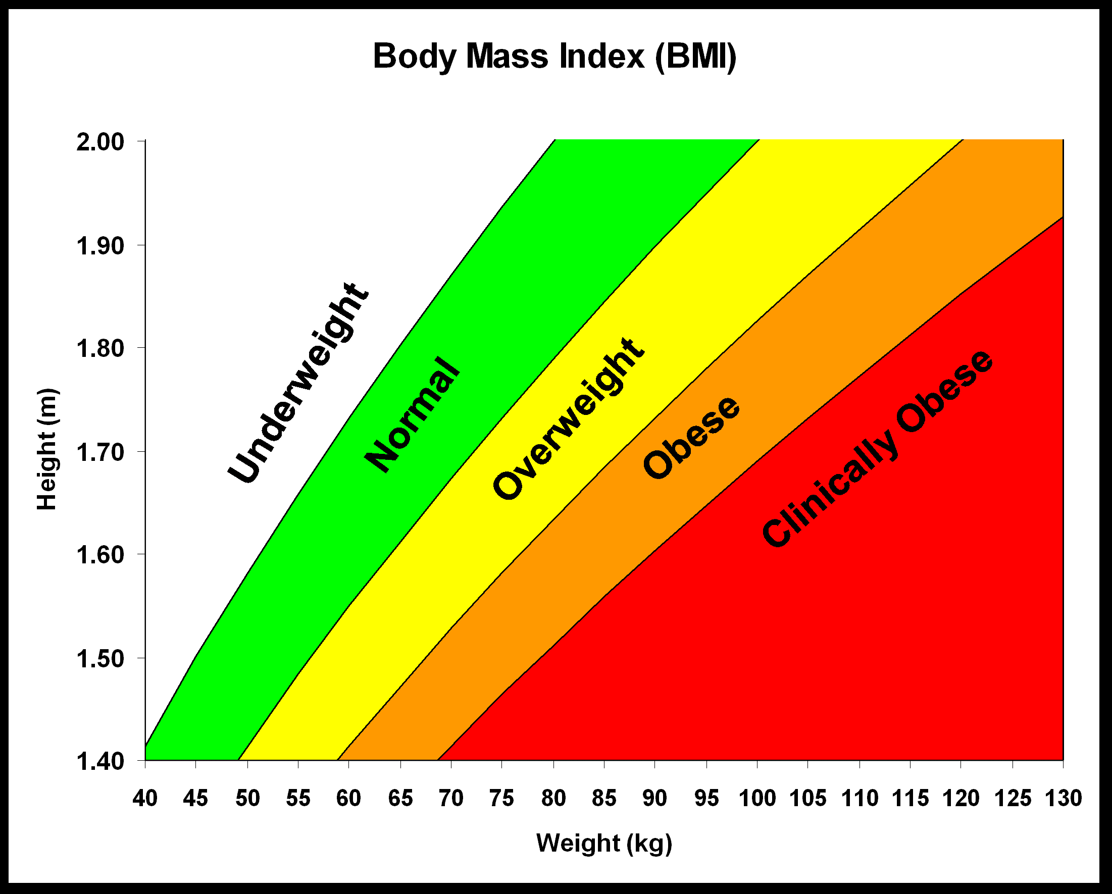
BMI

Slide 15
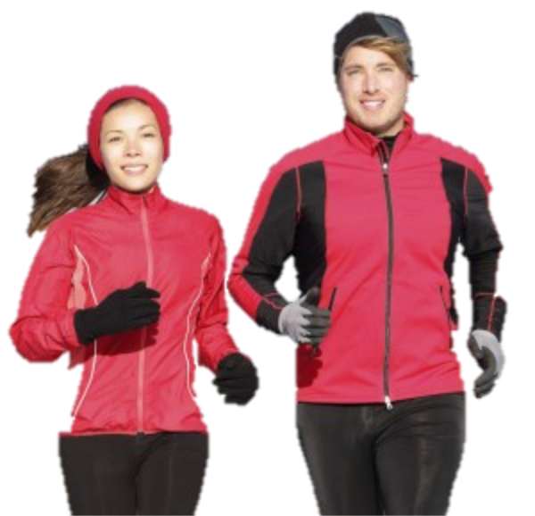
WELL DONE!
The average man should have 2200 calories a day.
The average woman should have 1900 calories a day.
Based on the average from different websites

Slide 16

WELL DONE!
Beats per minute or BPM is the number of times your heart contracts and relaxes (it’s a muscle) in a minute.
It varies from person to person as our hearts are all different strengths.

Slide 17
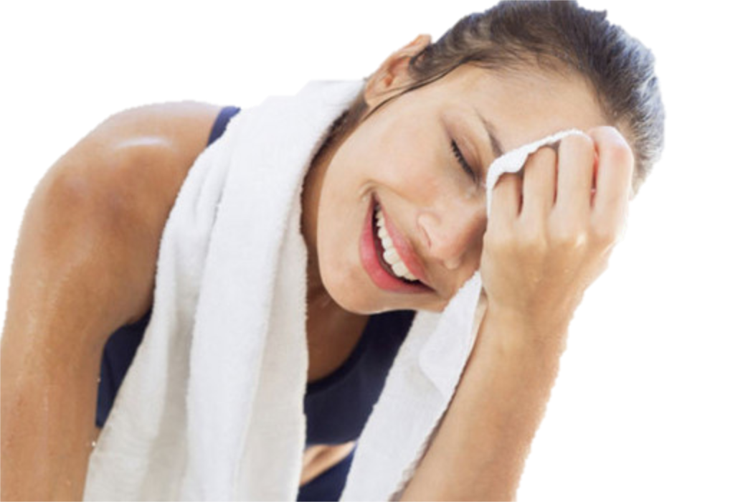
WELL DONE!
To calculate your Maximum heart the formula is: 220-age.
You must not exceed this or you risk damaging your organs.

Slide 18
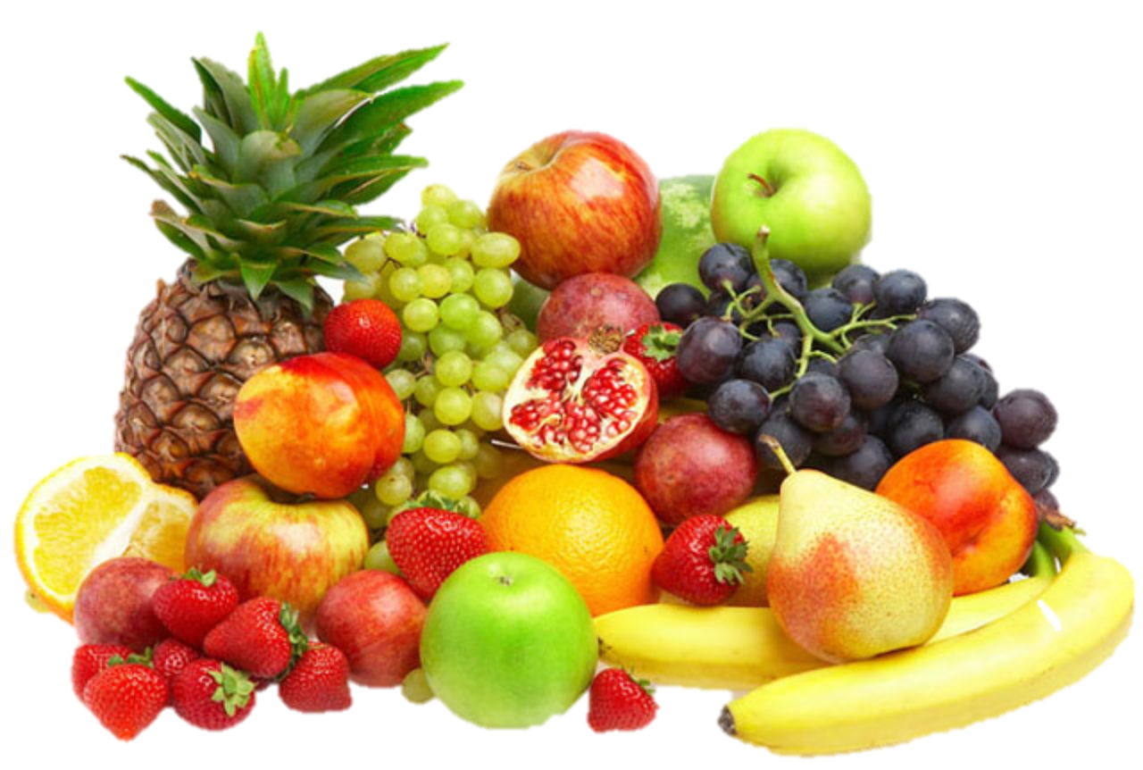
WELL DONE!
The WHO (World. Health. Organization) recommends 5-a-day, or 400g of fruit and or vegetables per day.
The reason for this is that it helps us maintain a balanced and healthy diet. It also helps reduce the risk of heart disease, strokes and some forms of cancer.

Slide 19

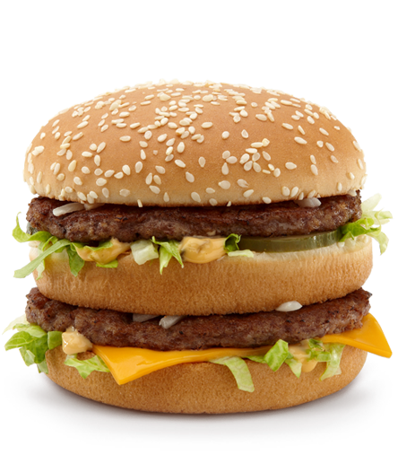
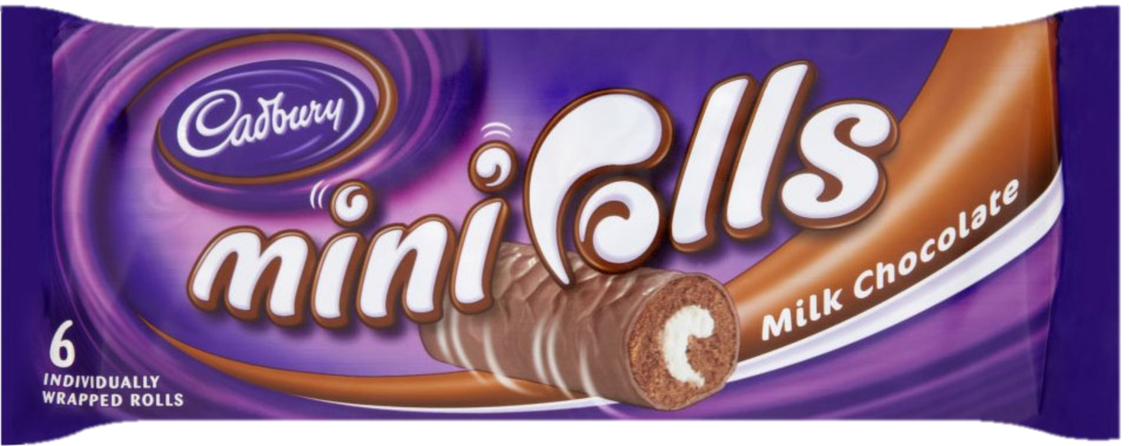
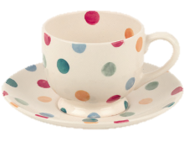
WELL DONE!
A Starbucks hot chocolate has 690 calories!
But a Big Mac only has 229
A Mini Roll has 116
A Tea and two sugars contain 32
YOU CAN KEEP HEALTHY BY SNACKING LESS

Slide 20
WELL DONE!
You should do at least 30 minutes of exercise 5 days a week. If you do this you can reduce your chance of having a heart attack by 50%
This does not have to be all in one go. It can be in bursts too.

Slide 21

INCORRECT
TRY AGAIN!

Slide 22

INCORRECT
In other countries such as Denmark it is 6 a day and in Singapore it is 4 a day. But in the UK it is…
There’s a clue below…

Slide 23
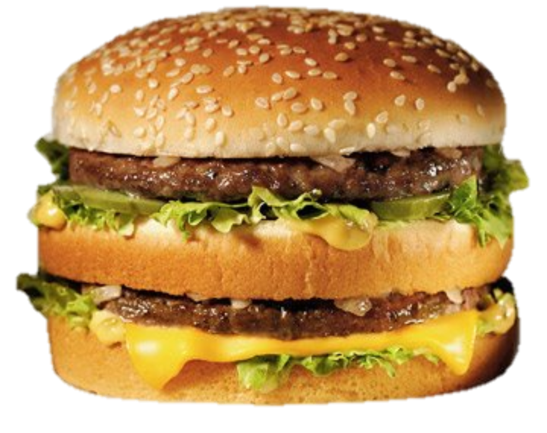
INCORRECT
You might think so, the Big Mac has always been labeled as an unhealthy snack but there’s something worse.
Here’s a clue: It’s liquid.

Slide 24

TERRIBLE
0-1
You really need to brush up on your health knowledge. If you don’t you’ll put on weight and this can cause early death.
TALLY UP
NOT TOO BAD
2-4
Your result wasn’t not good or bad. Just try and learn more about what you eat and how you can improve your diet and health.
AMAZING
5-7
You really know everything there is to know. Just remember to keep counting those calories and exercising.

Slide 25
WANT MORE?
BMI Calculator
Workout Planner
Calories in Food
Or Skip

Slide 26

THANK YOU
Submit Score
Scan this QR code to submit your score on your mobile
PLAY AGAIN
Or Skip

Slide 27
THANK YOU
PLAY AGAIN?
Or Skip

Slide 28
CLICK YOUR SCORE
0
1
2
3
4
5
6
7
Finished!

Slide 29
GET UP GET MOVING
Get up Get Moving is all about people becoming healthier.
CAMPAIGN WEBSITE
DONE

Slide 30
THANK YOU!
END QUIZ

